Slide 1
Parallelization of Local Sequence Alignment
PDC JCOMPONENT REVIEW-3

Slide 2
Team Members
-Bacham Sai Venkata Teja, 20BCE1551
-Jesmine Akhter, 20BCE1945
-Nilashma Saha, 20BCE1514
-Palesha Basumatary, 20BCE1229

Slide 3
Problem Statement
It is to draw a comparison between the serial and parallel implementation of Smith Waterman’s local sequence alignment algorithm for randomly generated nucleotide sequences.
Sequence Alignment problem is one of the fundamental problems of Biological Sciences, aimed at finding the similarity between two amino-acid sequences. Comparing amino-acids is of prime importance to humans, as it gives vital information about evolution and development. Saul B. Needleman and Christian D. Wunsch devised a dynamic programming algorithm for the problem and got it published in 1970.

Slide 4
Objectives:-
To obtain a highly efficient and simple implementation of the Smith-Waterman algorithm intended for local alignment of sequences.
To learn how to detect sequences in proteins and nucleic acids using parallel computing via implementation through multiple threads. Thus, learning how to apply parallel processing for real world problems.
We aim to create only a basic model with several limitations in mind, instead of a full-fledged model with be 100% accuracy.
By the end we expect to have a working model that is able to provide an accurate detection of sequences present.

Slide 5
Abstract
Parallel and Distributed computing is the future of technology. All products and their fundamental concepts are being shifted to a parallel computing model. Everybody would agree that serial computing is easy to implement and use, but simply not efficient enough for industry-level purposes. Due to this reason, day by day higher number of industries is providing and using cloud solutions that work on the basis of parallel and distributed computing. For instance, Amazon’s AWS or Google’s Google Cloud platforms are becoming the center for development, may it be in the field of web development, or in the field of data analytics.
But coming to the field of biotechnology, the doors to parallel computing have not been opened much yet. There is much scope in this field for the use of parallel computing, but understanding where will employing the same bear fruit is also an important task. To cope up with the fast-paced improvement in technology, domain familiarization is very important and so is exploring the domain to find out areas where parallel computing can be employed. This project is an attempt to do the same.
The Gene sequencing problem is one of the major issues for researchers regarding optimized system models that could help optimum processing and efficiency without introducing overheads in terms of memory and time. Bioinformatics and computational biology is the latest multidisciplinary field that explains many aspects of the fields of computer science, while computational biology harnesses computational approaches and technologies to respond to biological questions conveniently.

Slide 6
Algorithm Used for Parallelization of Smith-Waterman Algorithm
Ricart–Agrawala Algorithm:
To enter the Critical section:
When a site Si wants to enter the critical section, it sends a timestamped REQUEST message to all other sites. When a site Sj receives a REQUEST message from site Si, It sends a REPLY message to site Si if and only if site Sj is neither requesting nor currently executing the critical section. In case of Site Sj is requesting, the timestamp of Site Si‘s request is smaller than its request. Otherwise, the request is deferred by site Sj.
To execute the critical section:
Site Si enters the critical section if it has received the REPLY message from all other sites.
To release the critical section:
Upon exiting the site, Si sends a REPLY message to all the deferred requests.

Slide 7
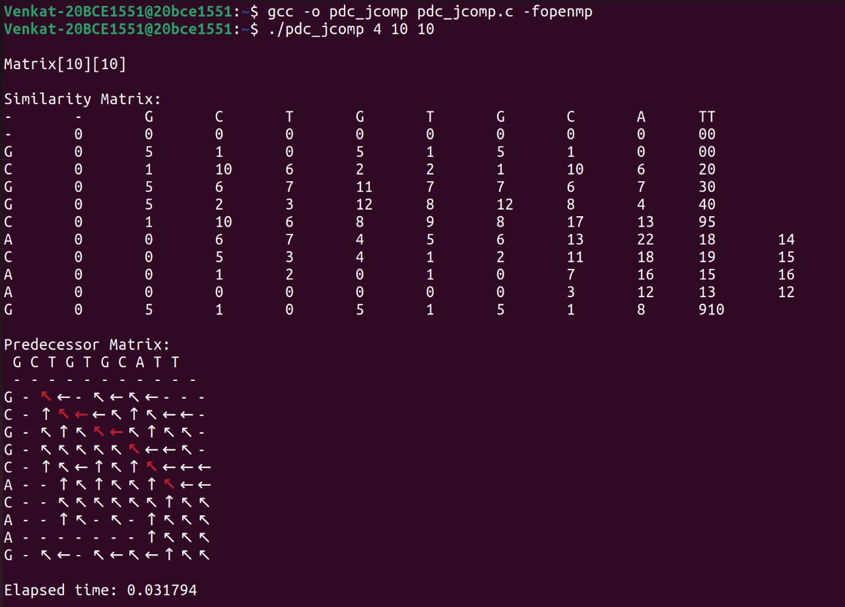
Code Output

Slide 8
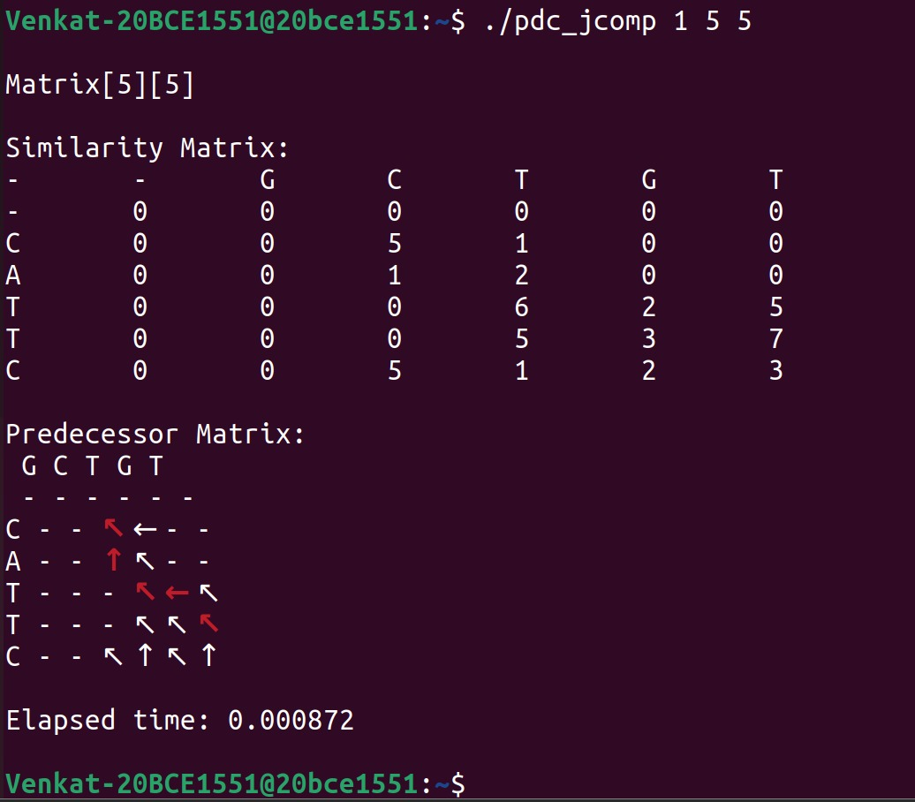

Slide 9
Procedure
The problem at hand was tackled with a modular approach. Eight functions were constructed, each of which are explained as follows:
nElement – This function is used to calculate the number of elements that have been found by the Smith-Waterman Algorithm. Three conditions are given: One of which is to find out if the number of elements in the diagonal are increasing, decreasing or stable. calcFirstDiagramElement – This function is used to calculate the position of the maximum scored value in the matrix. This value needs to be found because the algorithm suggests that the backtracking process to find the path should be started from this particular point.
similarityScore – It is used to find out the optimal order of execution based on three conditions, which is then used to calculate the new values of left, upper and the diagonal elements.

Slide 10
Procedure
matchMismatchScore – This function is used to calculate a similarity function or the alphabet for a match or mismatch. If the value of the two elements are equal, it is a match, otherwise, it’s a mismatch.
Backtrack – The purpose of this function is to modify the matrix that needs to be printed and helps us identify the path that needs to be taken to get the most optimum solution.
printMatrix – It’s a looped iteration implementation to display the matrix. printPredecessorMatrix - It is in this function in which we print the arrows depicting the path of local alignment.
Generate – This function generates the two sequences A and B which would be locally aligned with each other. A random seed is used to ensure the reproducible nature of the output.

Slide 11
Reference:-
http://www.ijritcc.org/download/1433580671.pdf
[A paper about the parallel implementation of the Smith-Waterman algorithm]
http://vlab.amrita.edu/?sub=3&brch=274&sim=1433&cnt=1 [Useful resource for learning about the algorithm in detail]
http://deeplearning.lipingyang.org/2017/01/30/openmp-on-ubuntu/ [Tutorial for interfacing and running openmp codes on Ubuntu terminal]
https://www.geeksforgeeks.org/backtracking-algorithms/
[Basic examples of backtracking and also dynamic programming to learn
and understand the algorithms]

